Slide 1
Chapter 8: Data manipulating Language
2023

Slide 2
Chapter 8: Data manipulating Language
Content:
Alter Clause
Rename Clause
Insert Into select Clause
Update
Delete
Description Clauses

Slide 3
ALTER
ALTER TABLE table_name ADD column_name datatype;
ALTER TABLE table_name
ADD (column_1 column_definition,
column_2 column_definition);
ALTER TABLE Customers ADD Email varchar(255);
ALTER TABLE Customers DROP COLUMN Email;
[SQL server]
ALTER TABLE table_name ALTER COLUMN column_name datatype;
[MySQL]
ALTER TABLE table_name CHANGE COLUMN column_name datatype;
Notes:
The ALTER TABLE statement is used to add delete change drop rename or modify columns in an existing table.
The ALTER TABLE statement is also used to add and drop various constraints on an existing table.
Alter TABLE tbl
Add Column …
Add primary key …
Alter table employees
Add pk_EmployeeID primary key (ID)
Change
Modify
Add
Drop
Rename
ALTER TABLE Persons ALTER COLUMN DateOfBirth year;

Slide 4
Alter
ALTER TABLE table_name
ALTER COLUMN column_name new_data_type(size);
ALTER TABLE Customers ADD Email varchar(255);
ALTER TABLE listings
ALTER COLUMN listing_name VARCHAR (60) NOT NULL;
Notes:
1-Change the size
2-Modify the data type
3-Add a NOT NULL constraint

Slide 5
Alter (Adding in a Specific Position) -MySQL
ALTER table table_name
Add column column_name integer AFTER column_name
ALTER table customers
Add column quantity integer AFTER price
Notes:
1-Change the size
2-Modify the data type
3-Add a NOT NULL constraint

Slide 6
Rename A table
MSQL
EXEC sp_rename ‘table name', ‘new table name’
MySQL
ALTER TABLE table_name RENAME TO new_table_name
Notes:
1 – or MySQL(?)
ALTER TABLE table_name RENAME TO new_table_name;
2 - RENAME TABLE offers more flexibility. It allows renaming multiple tables in one statement.
This can be useful when replacing a table with a new pre-populated version like:
→ RENAME TABLE products TO products_old products_new TO products;

Slide 7
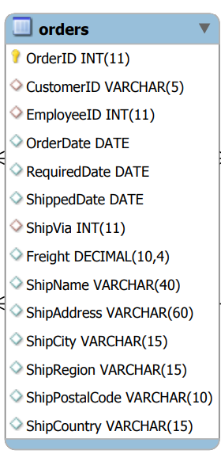
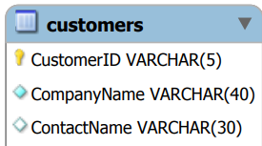
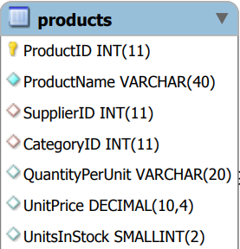
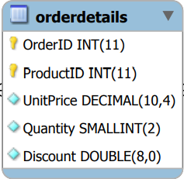
Create / alter / drop/Truncate/Rename
Create the ShopPty database
Create the following tables
Customers – stores customer master data
Orders – stores transaction sale orders from customers
OrderDetails – stores line items of sale orders
Products – stores products master data
Add a description column in Products table
Insert 1 row of data in each of these tables
Remove all the data inside the OrderDetails table
Delete the orderDetails table completely
Notes:
In future, int and float – no nrs to be added at the end for MySQL
Datetime use “-” instead of “/”

Slide 8
2. From the AirBnB database change the data type of birthdate in the Hosts table from DATETIME to only DATE
Notes:
ALTER TABLE `airbnb`.`host` CHANGE COLUMN `birthdate` `birthdate` DATE NULL DEFAULT NULL ;

Slide 9
insert into select
INSERT INTO table2 (column1 column2 column3 ...) SELECT column1 column2 column3 ... FROM table1 WHERE condition;
INSERT INTO Customers (CustomerName, ContactName, Address City, PostalCode, Country) SELECT SupplierName, ContactName, Address, City PostalCode ,Country FROM Suppliers;
Notes:
Advanced
SQL server: Select into from
for Mysql → you need a workaround]
You can also create more complicated SQL Server INSERT statements using SELECT statements.
INSERT INTO SELECT statement copies data from one table and inserts it into another table.
INSERT INTO SELECT requires that data types in source and target tables match
The existing records in the target table are unaffected

Slide 10
Insert Into Select
INSERT INTO contacts
(contact_id , last_name, first_name)
SELECT employee_id , last_name , first_name
FROM employees
WHERE employee_id <= 100;

Slide 11
Select into
Create a new table called HR_fulltime with the following fields: enrollee id, city and enrolled university.
By using the data from the HR_unknown table, of only for those who studied fulltime add this data into your newly created table.
HR

Slide 12
update
UPDATE table_name SET column1 = ’value1’
column2 = ’value2’ WHERE condition;
UPDATE Customers SET ContactName = ‘Alfred Schmidt‘
City= ‘Frankfurt’ WHERE CustomerID = 1;
Notes:
The UPDATE statement is used to modify the existing records in a table.
Note: Be careful when updating records in a table! Notice the WHERE clause in the UPDATE statement. The WHERE clause specifies which record(s) that should be updated. If you omit the WHERE clause all records in the table will be updated!
Update tbl
Set col1 = Johannesburg
Where col1 = JHB and
Col2 = Newly entered
https://www.universalclass.com/articles/computers/sql/using-the-update-statement-in-sql.htm
UPDATE Employees
SET FirstName = Nathaniel
WHERE FirstName = Nat ;

Slide 13
Update
Steps – Use listings table from AirBNB
First show all the host_names sort this in ascending order → Which 2 options does not look right?
How many entries are there with that value as host_name
Change the NULL value to “Not completed” and change the (Email hidden by Airbnb) to Hidden
Fix the international code from the phone number column so that it reads as +27
Notes:
MySQL if Safe update error:
Follow the following steps before executing the UPDATE command: In MySQL Workbench
Go to Edit --> Preferences
Click "SQL Editor" tab and uncheck "Safe Updates" check box
Query --> Reconnect to Server // logout and then login
Now execute your SQL query
a. Incorrect field entries: (Email hidden by Airbnb) & NULL values
b. 4 entries each
c. select * from listings
where host_name =
order by host_name;
select * from listings
where host_name = (Email hidden by Airbnb)
order by host_name;
Update listingsSet host_name = Case When host_name = (Email hidden by Airbnb) then Hidden When host_name = then Not completed End;
UPDATE employee SET phone = REPLACE( phone +1- +27- );

Slide 14
delete
DELETE FROM table_name WHERE condition;
DELETE FROM Customers WHERE CustomerName= ‘Albert Smith’ ;
Notes:
The DELETE statement is used to delete existing records in a table.

Slide 15
Note: Be careful when deleting records in a table
Notice the WHERE clause in the DELETE statement. The WHERE clause specifies which record(s) should be deleted. If you omit the WHERE clause all records in the table will be deleted

Slide 16
MySQL: DESC Statement (Describe Table)
SQL DESC statement use for describe the list of column definitions for specified table. You can use either DESC or DESCRIBE statement. both are return same result.
DESCRIBE statement to get following information:
Column Name
Column allow NULL or NOT NULL
Datatype of the Column
With database size precision and If NUMERIC datatype scale.
Notes:
SQL server - Sp_columns tableName

Slide 17
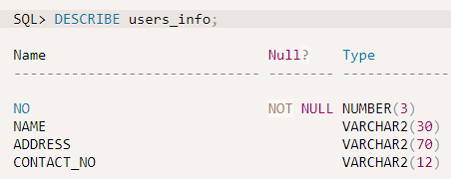
DESC table_name

Slide 18
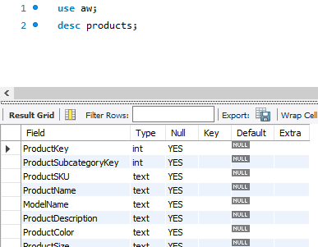
desc

Slide 19
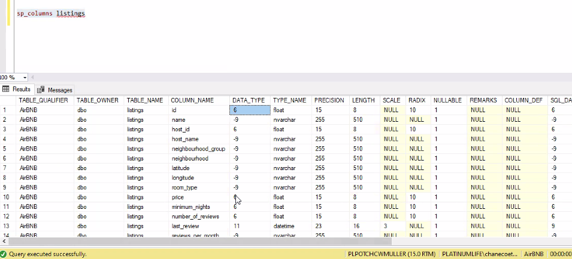
SQL server
Sp_columns tableName

